Slide 1
Coursera Capstone Project Choose The Right Hotel To Stay In
Radoslaw Cholewinski, May 2020

Slide 2
Business Case
Hotel search engine provide users with simple filters
It would be useful to differentiate between hotels based on venues, which are located within a walking distance (e.g. close to restaurants, close to sightseeings)
k-means algorithm could be implemented to cluster hotels using location data from the Foursquare API
Commercial applications:
More efficient hotel search engines
Targeting users of booking websites
Price discrimination for booking websites
Differentiation of tourist tax by local authorities

Slide 3
Data
Data for Naples, Italy
98 recommended hotels by Foursquare, of which 89 analyzed
3600 different venues within 500 m distance from each hotel
139 categories of venues
In each hotel’s neighborhood there are on average 40 venues

Slide 4
Methodology
Simple k-means clustering algorithm
Features:
One-hot encoding of venues based on their category
For each hotel the number of occurrences of a given venue is divided by the largest numer of occurrences of that venue for all hotels – score
Choice of k
More an art than science
It is desirable that clusters can be assigned with meaningful labels
Value of k may affect the shape of clusters
Too many clusters don’t really provide information

Slide 5
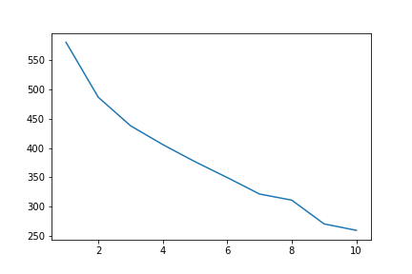
Results
Inertia shows the steepest decline for k between 2 and 7

Slide 6
Results
For k = 3 and k = 4 hotels within a cluster are physically located close to each other, and there exists one cluster of other hotels
When k = 5, additional cluster consists of only two hotels
For k = 4 clusters can be meaningfully labeled:
#0 – delis, sandwiches, fried chicken, plazas – tourist area (or tourist traps)
#1 – pizza places, convenience stores, diners, public transport, Italian restuarant – great for independent travellers
#2 – Asian restaurants, convenience stores, fountains, hotels, hostels – typical hotel district
#3 – bakeries, food & drink shops, gift shops, candy stores – main train station neighborhood

Slide 7
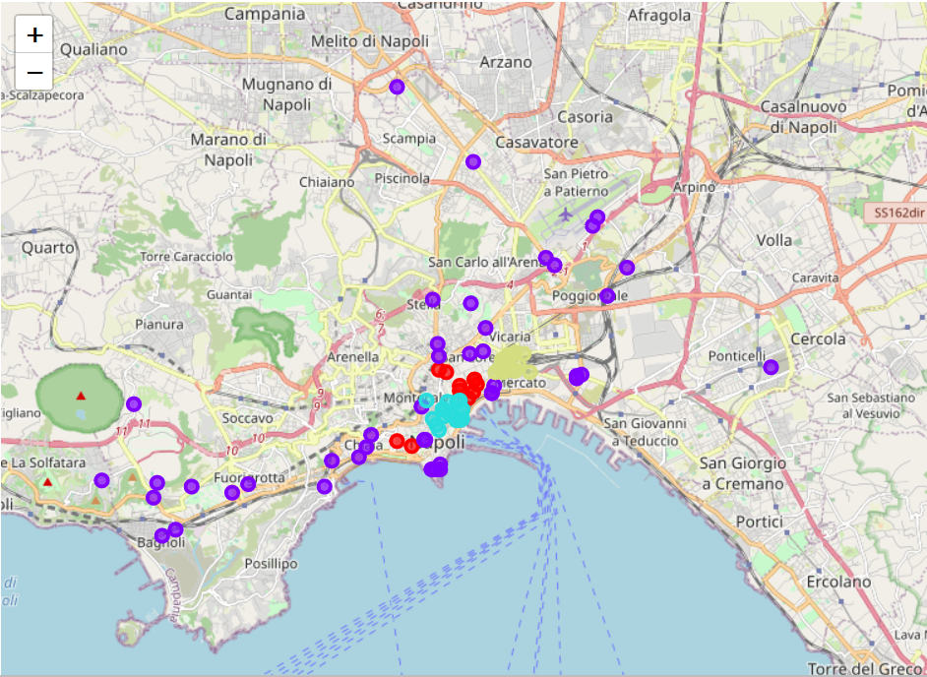
Results – clusters visualized
Red – tourist area (traps)
Blue – independent travelers
Pink – hotel district
Green – train station area

Slide 8
Discussion
Each cluster caters for different kinds of tourists
Three clusters located in physical neighborhoods (tourist sights, hotel district and train station)
One cluster spread across the city (not one physical neighborhood) with hotels close to local restaurants, convenience stores and public transport – choice for independent travelers
Based on existing filters in hotel search engines, it would be difficult to identify the ‚independent traveler cluster’

Slide 9
Recommendations
Hotel search engines could be enhanced by clustering hotels using simple k-means algorithm
Hotel clusters could be labelled on a basis of the most common venues near hotels within each cluster
Great tool for booking sites (targeting users, price discrimination)
Local authorities could use cluster analysis to differentiate tourist tax

